Slide 1
Mobile sauna!
A project, wanted for many years.
A project lasting VERY long!
A project, becoming surprisingly expensive!
See how it went here:

Slide 2
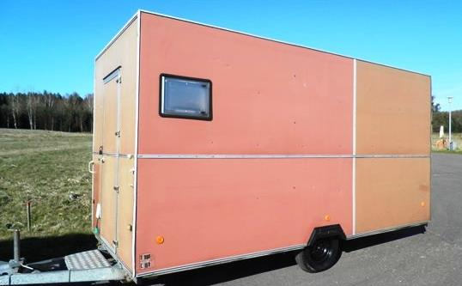
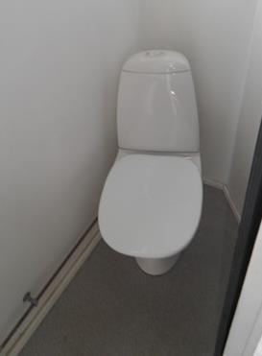
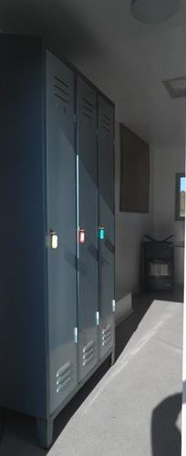
Buying the base for the mobile- sauna:
Target: A second hand crew carriage or camping caravan as base for conversion to a mobile sauna.
We thought we made a good deal in May 2015l!!?
With toilet, sink, wardrobes, table and bookcase = 250 kg overweight!!
Notes:
Price: Dkr. 13.500,- = € 1.800,-

Slide 3
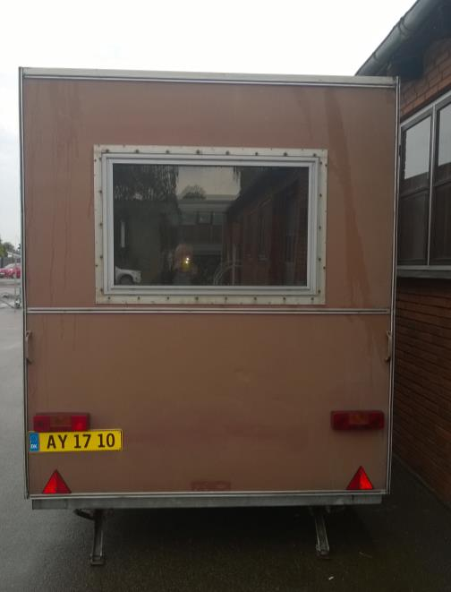
Mobile sauna!
  Before we really started the conversion, we wanted to be sure that it pass scrutineering and get registration plates – and the time of miracles are not over – it went through in the 1st attempt!
  And another miracle: We got it registered with a copy of the old registration attest!?! (We were apparently also had on this item!)
  So it got the number plates already on
  August the 31st 2015!
Notes:
Price: 750 kr. = 100 €

Slide 4
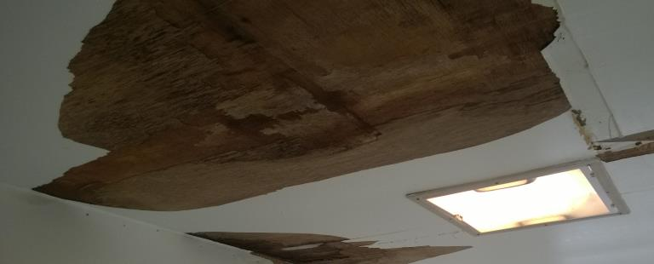
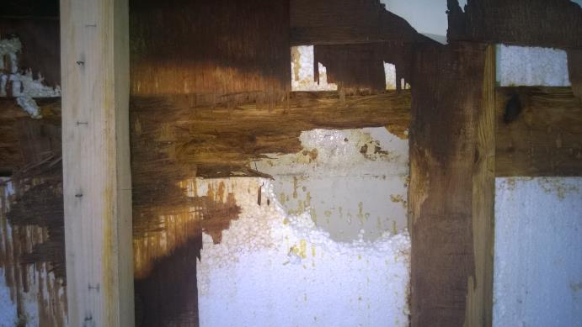
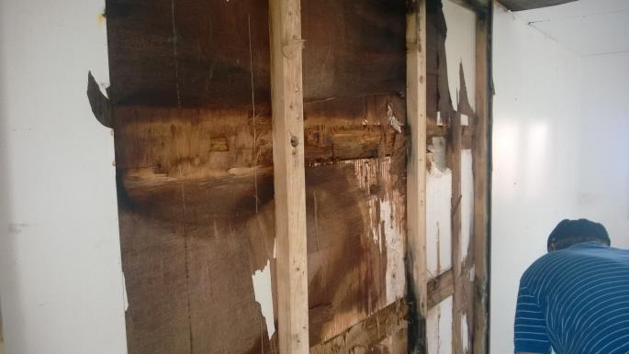
Mobile sauna!
We thought we just needed to remove the
obsolete inventory and replace the nice white walls and ceiling with wood panels, and then just mount the benches and the stove – But we got wiser!!!
Behind the nice white panels, there were rottenness and mold!

Slide 5
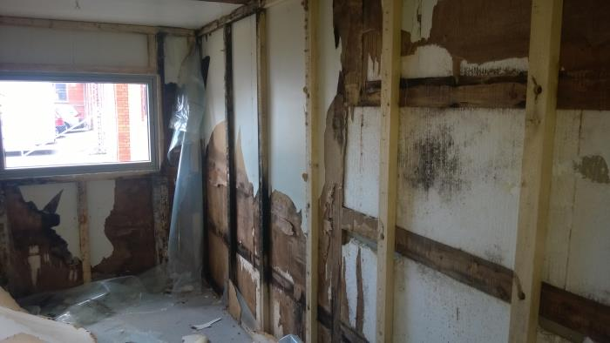
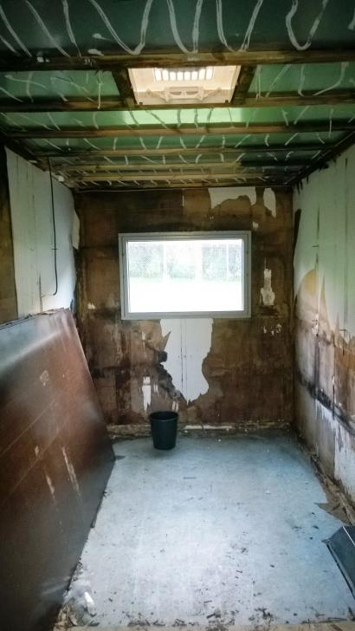
Mobile sauna!
  The more we peeled off, the worse it became!

Slide 6
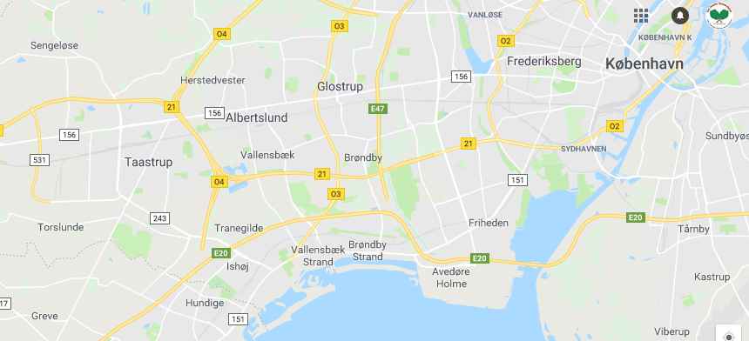
Mobile sauna!
In the peeling off period, we were forced to chance residence 5 times:
Ishøj Senior workshop,
At Danish Carpet & Floor service in Greve,
In a private P-place in Glostrup,
In an allotment association on Amager.
At Eslau ceramics factory in Sengeløse.

Slide 7
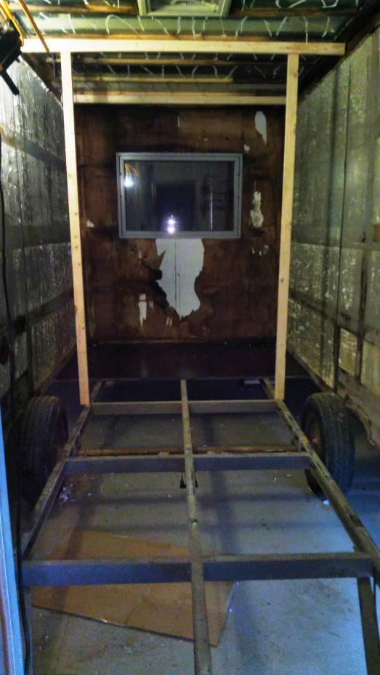
Mobile sauna!
Gradually it looked more and more confusing!
So we found a pensioner, who had previously renovated several caravans to carry out the rough and professional work
And we also had to find a place under cover where he could work!
Then the carriage was split completely so that only the roof, the outer walls and the undercarriage were left.

Slide 8
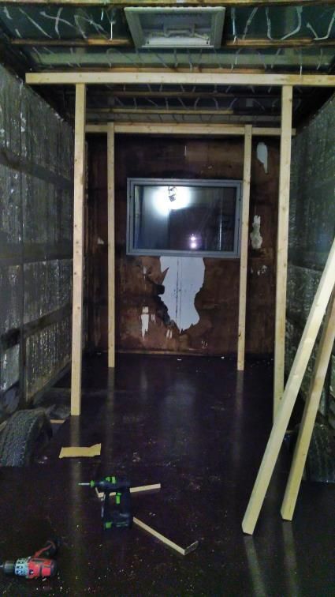
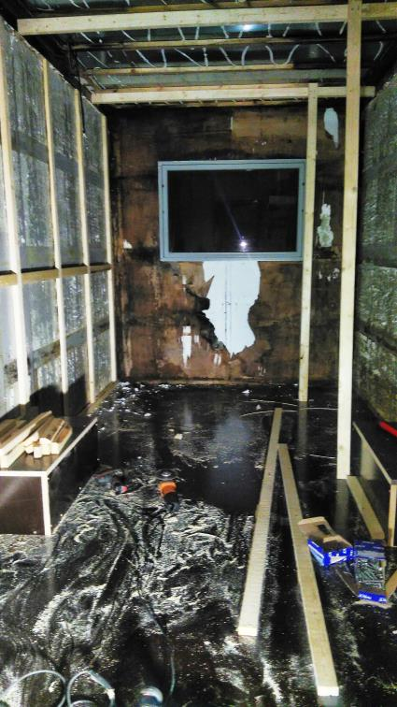
Mobile sauna!
Then the casting veneer floor was mounted to the chassis enabling it to carry the walls and roof!
The wheel arches were rebuild in casting veneer replacing the thin plastic ones.
The old floor was a sandwich construction with twin layers of plywood with polystyrene insulation between. We saved weight with only 1 layer of veneer – the weight has constantly been a challenge!

Slide 9
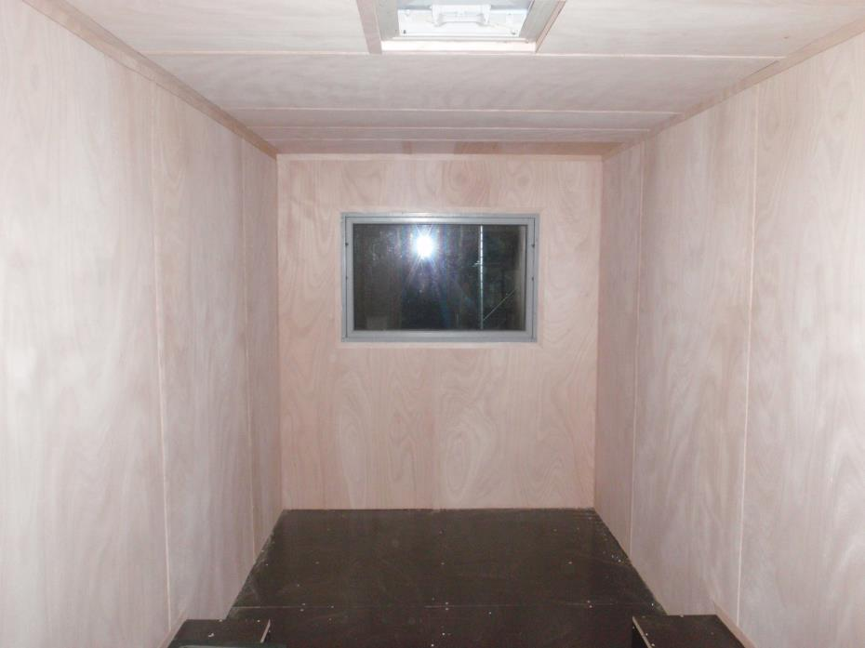
Mobile sauna!
New internal covering from 4 mm Okoumé plywood with 25 mm styrene insulation behind.

Slide 10
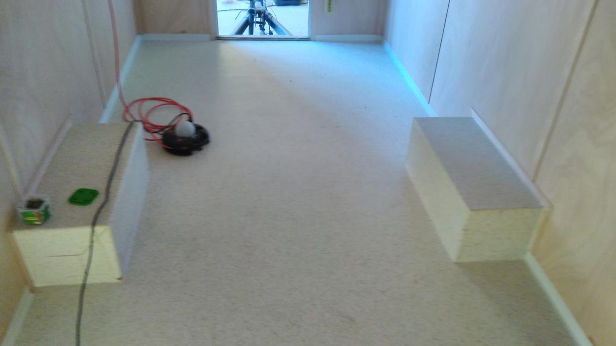
Mobile sauna!
And then we got help from Christian Rason from Dansk Tæppe & Gulvservice for non-skid PVC coating on the slippery casting veneer floor.

Slide 11
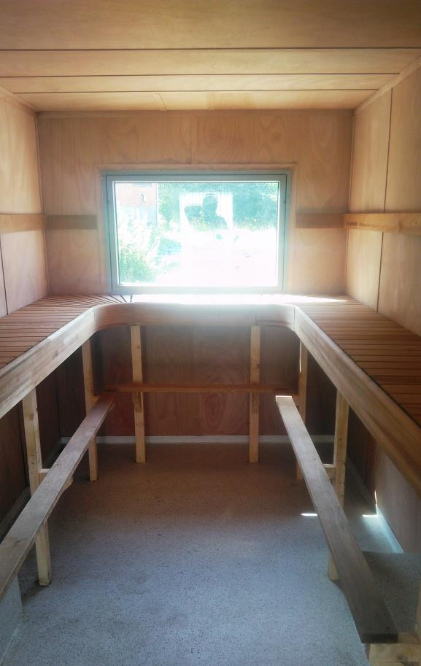
Mobile sauna!
And then just the benches!
Which we imported from Finland at half the price of what they cost in Denmark and Sweden! Even when the freight was included! It is thermo asp! For the sake of weight, we only mounted one bench which became very high! (The rule is that the feet must be in line with the stove's stones!) This asked for an additional foot rest!

Slide 12
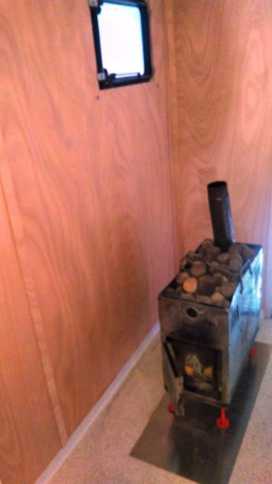
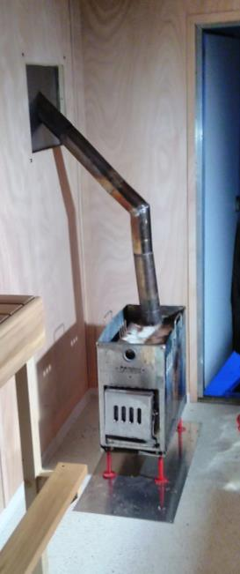
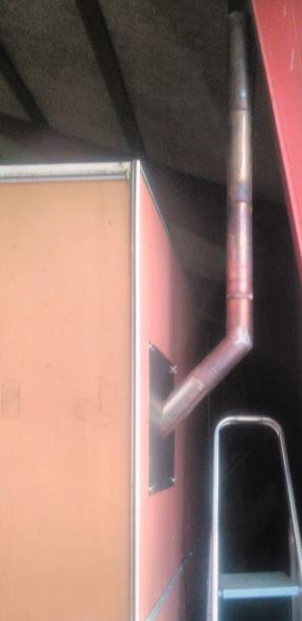
Mobile sauna!
No sauna without stove! And it should be lightweight!
So we "stole" the stainless Mobiba stove from one of our tent sauna’s.
And made a stainless steel plate that could be inserted instead of the side window to get the chimney through, which should also have 2 pcs. 45 gr. angles! Rikko “Stainless” made it for us!

Slide 13
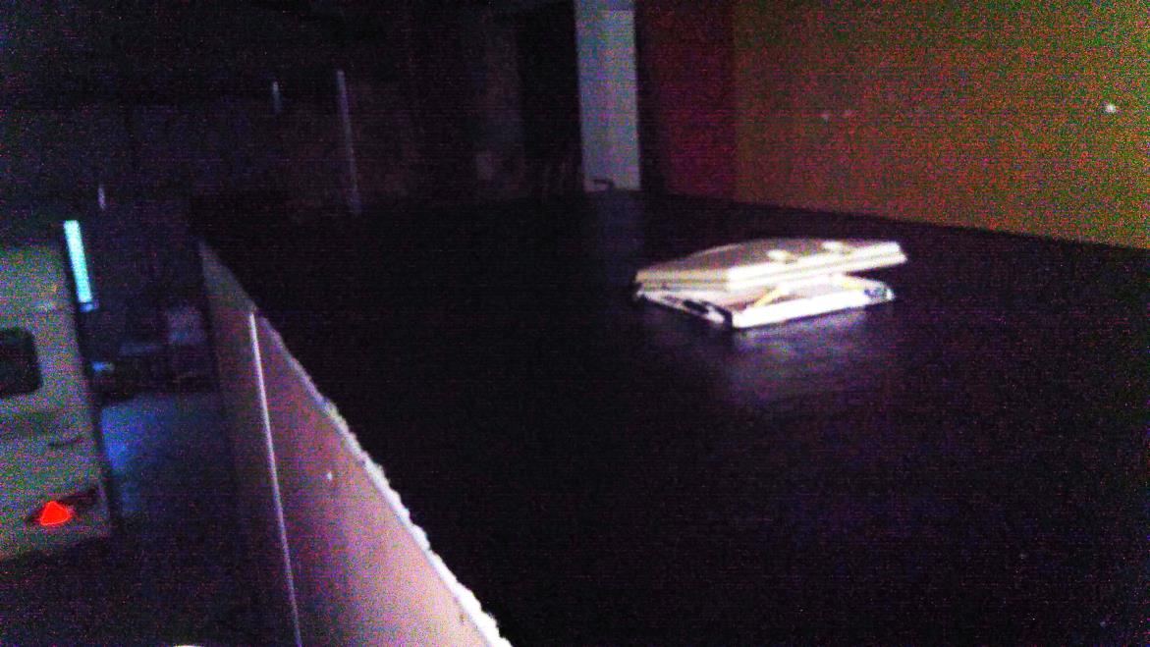
Mobile sauna!
Before the mobile sauna were to be let out, "on grass" the roof had to be sealed as there appeared to be several small holes in it. So “Borup Tagtæt” with a consistency like honey was applied, so it was applied with floor scrub and spatula!
Really hard work!

Slide 14
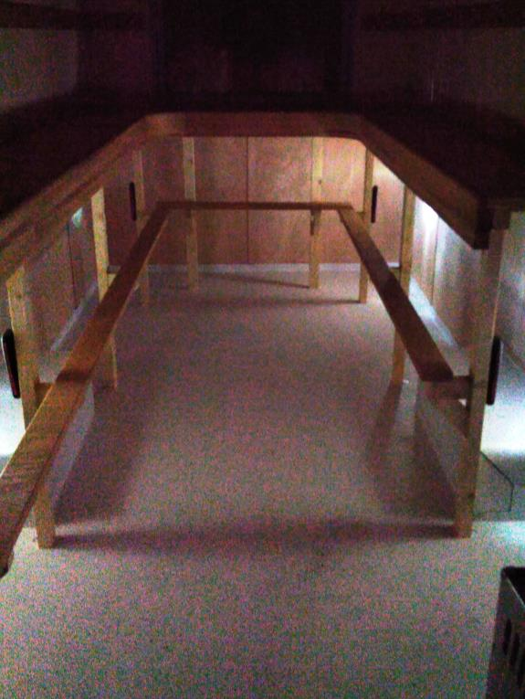
Mobile sauna!
We should also have lighting! Originally we wanted LEDs in the ceiling, but it became too expensive and complicated, so we were pleased with battery-powered LED lights on the benches legs.

Slide 15
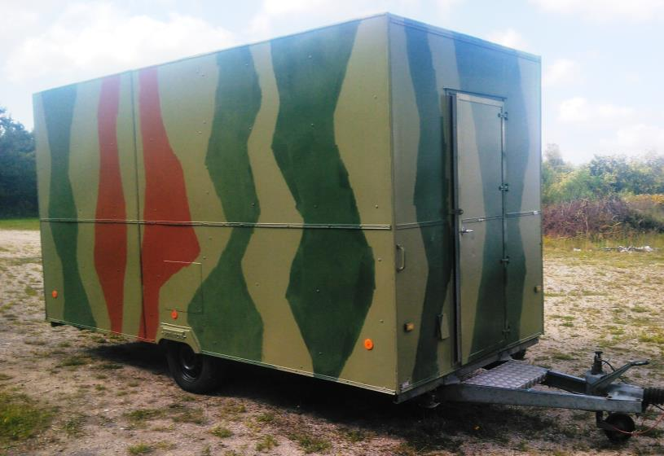
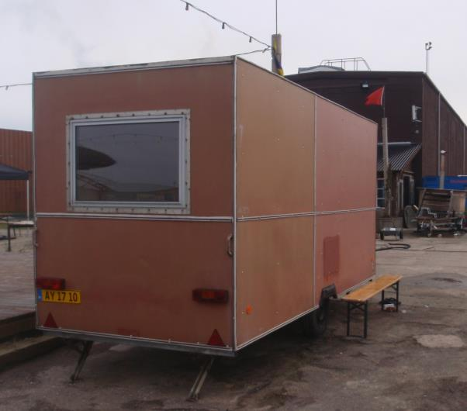
Mobile sauna!
And then there was just the outside!
People called it "the brown box" so we decided it should be painted in natural colours!
Before!
After!

Slide 16


Mobile sauna!
We appreciate the help from:
Ishøj Senior Workshop, Dansk Tæppe og Gulv Service,
The Sauna Association’s board members, who all helped according to
their best ability and conviction, as well as “Tuborg’s Green Fund” and the Danish Outdoor Council. Without this invaluable support, this project was simply capsized!

Slide 17

Mobile sauna!
The budget and eventual costs?
1. Budget: Trailer, Dkr. 15.000,- (2.000,- €)
  Conversion to sauna: Dkr. 15.000,- (2.000,- €)
2. Budget: Conversion: Dkr. 30.000,- (4.000,- €)
Final costs for trailer & conversion: Dkr. 71.000,- (9.500,- €)

